Slide 1
OVERVIEW OF AZURE DEVOPS

Slide 2
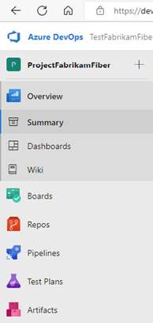
What is DevOps:
It allows organizations to create and improve products at a faster pace than they can with traditional software development approaches.
It provides an integrated set of services and tools to manage software projects, from planning and development through testing and deployment.

Slide 3
What are its basic functions:
Azure DevOps provides integrated features that you can access through your web browser or IDE client. We can use all the services included with Azure DevOps, or choose just what you need to complement your existing workflows.
Standalone service | Description
Azure Boards | Delivers a suite of Agile tools to support planning and tracking work, code defects, and issues using Kanban and Scrum methods.
Azure Repos | Provides Git repositories or Team Foundation Version Control (TFVC) for source control of the code
Azure Pipelines | Provides build and release services to support continuous integration and delivery of the applications.
Azure Test Plans | Provides several tools to test your apps, including manual/exploratory testing and continuous testing.
Azure Artifacts | Allows teams to share packages such as Maven, npm, NuGet, and more from public and private sources and integrate package sharing into the pipelines.

Slide 4
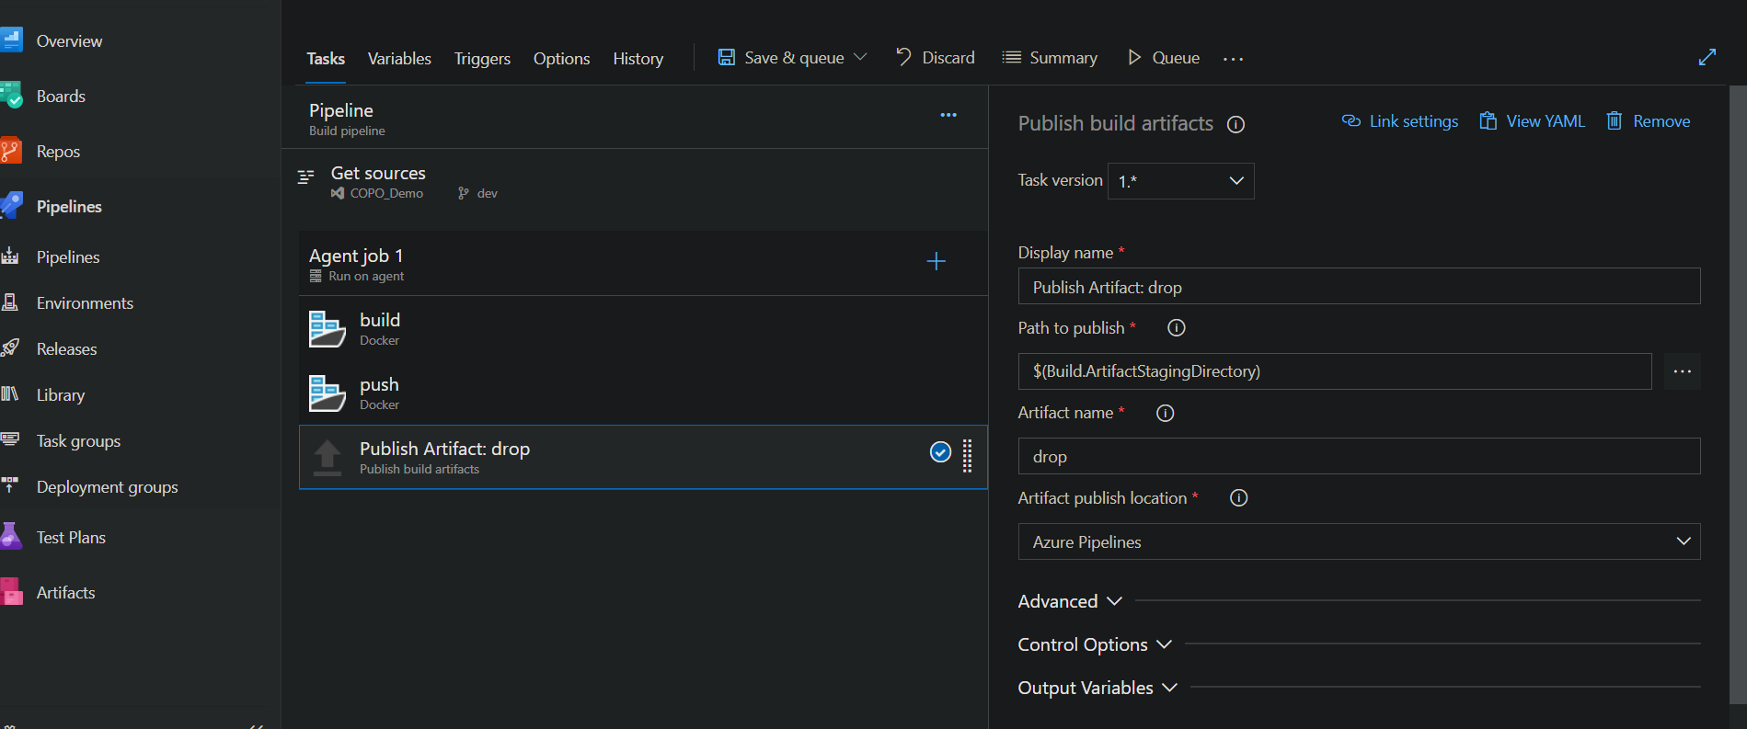
UI:

Slide 5
OVERVIEW
Dashboards:
Gain access to user-configurable dashboards from Dashboards.
We can do the following tasks in Dashboards:
Add, configure, and manage dashboards
Configure widgets that you add to dashboards
Go to different areas of your project quickly
Wiki:
Use team project wiki to share information with other team members. When we provision a wiki from scratch, a new Git repository stores our Markdown files, images, attachments, and sequence of pages. This wiki supports collaborative editing of its content and structure.

Slide 6
Boards:
Software development projects require ways to easily share information and track the status of work, tasks, issues, or code defects. In the past, you might have used Microsoft Excel, Microsoft Project, a bug tracking system, or a combination of tools. Now, many teams have adopted Agile methods and practices to support planning and development.
From Boards, we gain access to Agile tools to support planning and tracking work.
We can do the following tasks with boards:
Add and update work items
Define work item queries, and create status and trend charts based on those queries
Manage your product backlog
Plan sprints by using sprint backlogs
Review sprint tasks and update tasks through the task boards
Manage portfolios by grouping stories under features and grouping features under epics
Use task boards during daily Scrum meetings to review work that's completed, remaining, or blocked

Slide 7
Repos:
Source or version control systems allow developers to collaborate on code and track changes made to the code base. Source control is an essential tool for multi-developer projects.
It support two types of source control: Git or Team Foundation Version Control (TFVC). You can check in files and organize files within folders, branches, and repositories in both systems.
With Git, each developer has a copy on their dev machine of the source repository, including all branch and history information. Each developer works directly with their own local repository and changes are shared between repositories as a separate step.
From Azure Repos for Git, you can do the following tasks:
Review, download, and edit files, and review the change history for a file
Review and manage commits that have been pushed
Review, create, approve, comment on, and complete pull requests
Add and manage Git tags

Slide 8
Azure Pipelines:
Azure Pipelines automatically builds and tests code projects to make them available to others. It works with just about any language or project type. Azure Pipelines combines continuous integration (CI) and continuous delivery (CD) to test and build your code and ship it to any target.
The starting point for configuring CI and CD for your applications is to have your source code in a version control system. Azure DevOps supports two forms of version control - Git and Azure Repos. Any changes you push to your version control repository will be automatically built and validated.
Continuous Integration (CI) is the practice used by development teams of automating merging and testing code.
It helps to catch bugs early in the development cycle.
Automated tests execute as part of the CI process to ensure quality.
Artifacts are produced from CI systems and fed to release processes to drive frequent deployments.

Slide 9
Continuous Delivery (CD) is a process by which code is built, tested, and deployed to one or more test and production environments.
CI systems produce deployable artifacts, including infrastructure and apps.
Automated release processes consume these artifacts to release new versions and fixes to existing systems.
Monitoring and alerting systems run continually to drive visibility into the entire CD process.
Deployment targets:
We can deploy our code to multiple targets.
Targets include virtual machines, environments, containers, on-premises and cloud platforms, or PaaS services.
Once we have continuous integration in place, the next step is to create a release definition to automate the deployment of our application to one or more environments.

Slide 10
Test Plans:
Test Plans supports creating and managing manual, exploratory, and continuous tests.
With test features, you gain access to the following features:
Customization of workflows with test plan, test suite, and test case work items
End-to-end traceability from requirements to test cases and bugs with requirement-based test suites
Criteria-based test selection with query-based test suites
Excel-like interface with the grid for easy creation of test cases
Reusable test steps and test data with shared steps and shared parameters
Sharable test plans, test suites, and test cases for reviewing with Stakeholders
Browser-based test execution on any platform
Real-time charts for tracking test activity

Slide 11
Azure Artifacts:
Azure Artifacts enables developers to share their code efficiently and manage all their packages from one place. With Azure Artifacts, developers can publish packages to their feeds and share it within the same team, across organizations, and even publicly. Developers can also consume packages from different feeds and public registries such as NuGet.org or npmjs.com. Azure Artifacts supports multiple package types such as NuGet, npm, Python, Maven, and Universal Packages.
Azure Artifacts is free for every organization up to 2 GiB of storage.

Slide 12
THANK YOU

